Slide 1

RESUME CLASSIFICATION

Slide 2
TEAM MEMBERS:-
Arav Kumar
Agna P
Muskan Betageri
Amar Krishna Kamble
Chetan Appanna Rathod
Shivkumar Ganiger
2

Slide 3

BUSINESS OBJECTIVE
This project aims to streamline the recruitment process and help HR professionals ,recruiters , and hiring managers quickly sort and match resumes with the most suitable job positions

Slide 4
EXPLORATORY DATA ANALYSIS (EDA)
Exploratory Data Analysis (EDA) is a critical step in the data analysis process.
It involves analyzing the main characteristics of the data set, often visualizing
the data, to understand its structure, discover patterns, spot anomalies, and
check assumptions before applying more advanced statistical methods or
machine learning algorithms.
EDA helps in:
Summarizing the dataset: By using descriptive statistics to get insights into the data, such as mean, median, mode, variance, and standard deviation
Visualizing the data: Employing plots like histograms, bar charts, box plots, scatter plots, and heatmaps to get a better understanding of the distribution and relationships in the data.
Identifying outliers and anomalies: Detecting unusual data points that might indicate
data entry errors or significant insights.
Handling missing values: Understanding the nature and extent of missing data to decide on appropriate methods for dealing with them, such as imputation or removal

Slide 5
TECHNIQUES
Handling Missing Values: Identifying and addressing missing data through techniques such as imputation, deletion, or using algorithms that can
handle missing values.
Outlier Detection: Identifying unusual data points that can skew the analysis. Techniques include using, IQR methods, and visual inspections via box plots
Feature Selection: selecting the most important features using hypothesis
testing and using ols method and using random forest regressor it gives the importance score of features.
Data Scaling : using the standard scaler we scaled the data that is
beneficial for our model to learn patterns amongs the data.

Slide 6

TOOLS & LIBRARIES
S
DATA MANIPULATION:
Pandas, Numpy Data visualization: Matplotlib, Seaborn
Data Preprocessing:
Use Regular Expression, Train Test Split
Model Building:
Scikit-learn
Model Evaluatio:
Scikit-learn
Model Deployment:
Pickle, Streamlit
IDE:
Jupyter Notebook, Google Colab

Slide 7
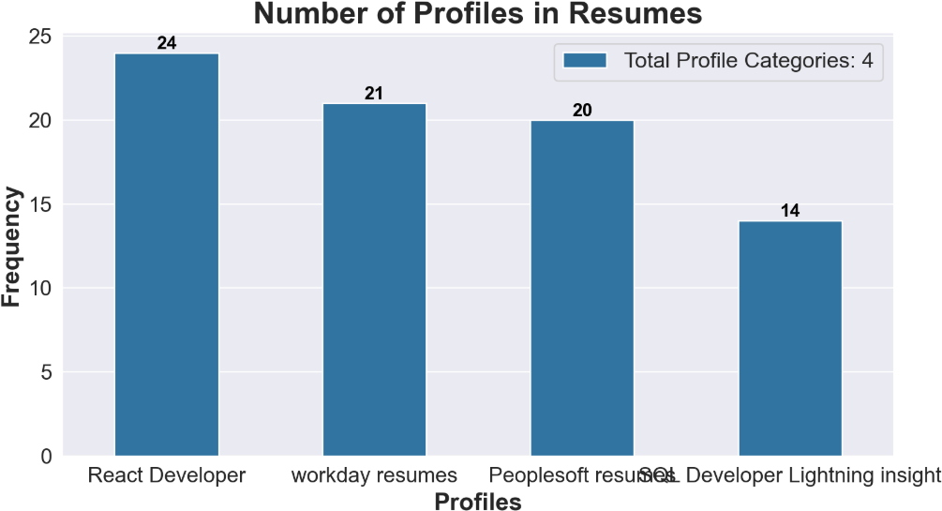
REPRESENTING NUMBER OF PROFILES IN
RESUMES BY BAR PLOT

Slide 8
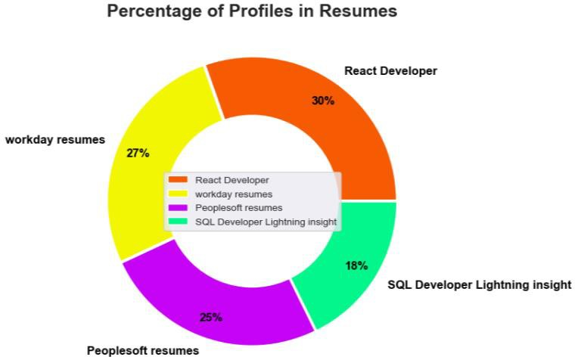
REPRESENTING NUMBER OF PROFILES IN
RESUMES BY PIE PLOT

Slide 9
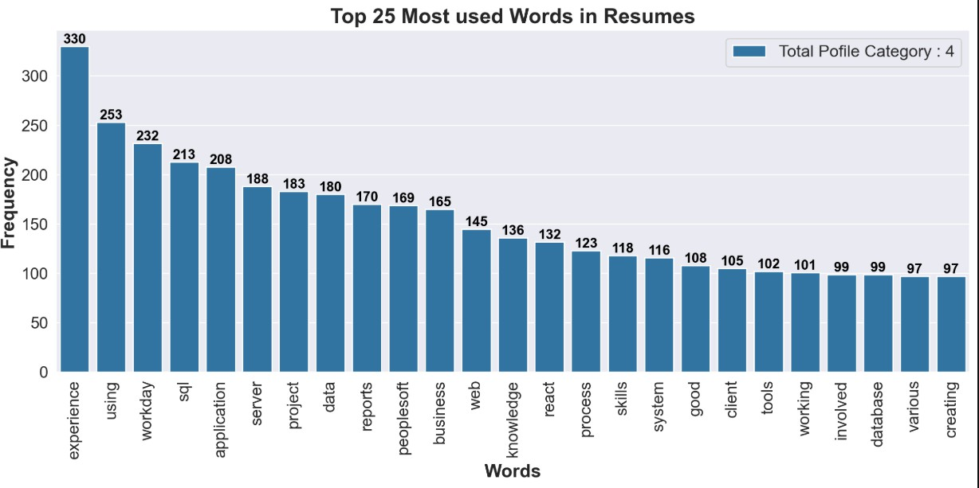
TOP 25 MOST USED WORDS

Slide 10
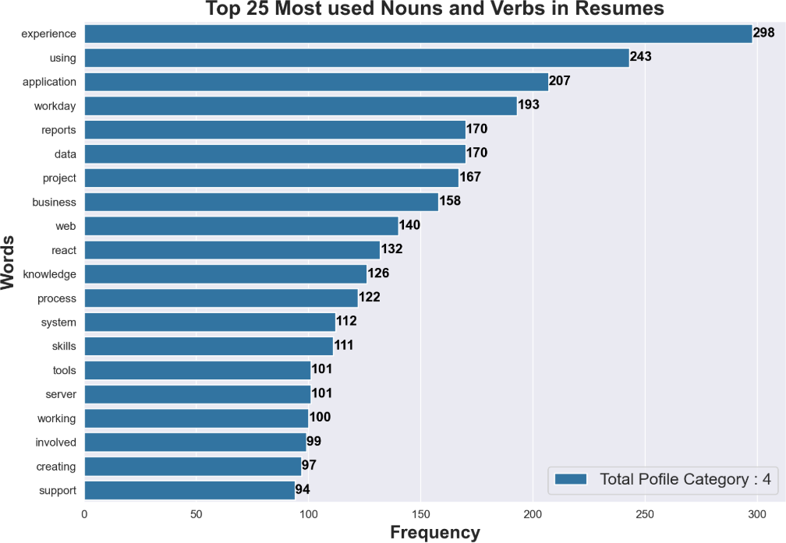
TOP 25 MOST USED NOUNS AND
VERBS

Slide 11

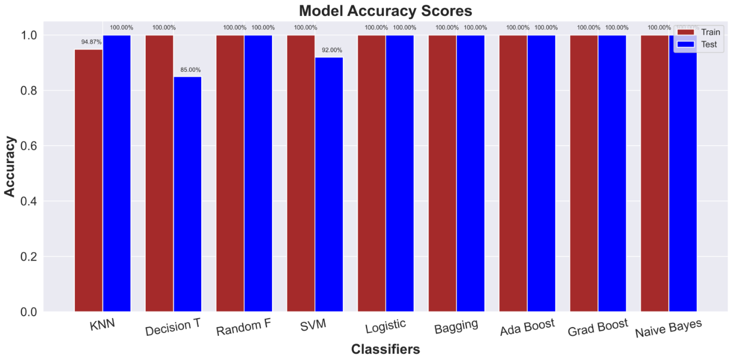
ALGORITHMS USED AND IT'S VISUALIZATION
KNN
DECISION TREE
RANDOM FOREST
SVM
LOGISTIC
BAGGING
ADA BOOST
GRAD BOOST
NAÏVE BAYES

Slide 12
CHOOSE MODEL
Here we used nine type of algorithms
KNN
DECISION TREE
RANDOM FOREST
SVM
LOGISTIC
BAGGING
ADA BOOST
GRAD BOOST
NAÏVE BAYES
Here we choose Logistic algorithms for Deployment because it gives the accuracy Of Training set = 100% and Test set = 100%.
Precision, Recall, and F1 Score = All are 1.00 for each category. It means the models made perfect predictions for each category

Slide 13

MODEL BUILDING
Model Selection & Training
Baseline Models:
Logistic Regression
Naïve Bayes
Support Vector Machine (SVM)
KNN
Advanced Models:
Random Forest, XGBoost (for traditional ML)
Model Training & Optimization :
First sparate the target and feature columns
Split data into training (80%) and testing (20%).
Define the model.
Train the model
Validate the model
Used GridSearchCV for hyperparameter tuning.

Slide 14

MODEL EVALUATION METRICS
Accuracy: Measures the overall correctness of the model by calculating the ratio of correctly predicted instances to the total instances.
Precision: Indicates the proportion of true positive predictions out of all positive predictions made by the model, reflecting its accuracy in identifying relevant instances.
Recall (Sensitivity): Measures the model's ability to correctly identify all relevant instances by calculating the proportion of true positives to the actual positive instances.
F1 Score: Provides a harmonic mean of precision and recall, balancing the two metrics, especially useful when there is an uneven class distribution. Lower is represents the proportion of variance in the dependent variable explained by the independent variables. Higher is better.

Slide 15
MODEL DEPLOYMENT USING STREAM-LIT
Stream-lit is a powerful Python library that allows you build and share data apps with minimal coding effort. It's perfect for quickly prototyping and deploying machine learning models.
Why we use Stream-lit:
Simplicity: Create interactive web apps with just Python code.
Speed: Rapid development and deployment.
Flexibility: Customize your app's appearance and functionality.
Sharing: Easily share your app with others.

Slide 16
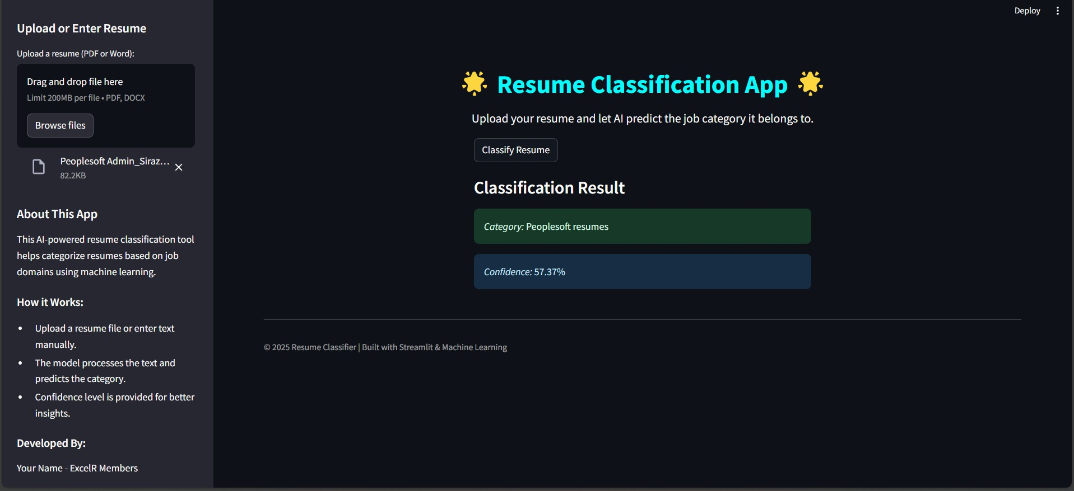
STREAM-LIT UI

Slide 17

CHALLENGES & LEARNINGS
Challenges:
Selecting the important features and best model.
Setting up Streamlit for deployment.
Underfitting and Overfitting Of Model
Learnings:
Importance of hyperparameter tuning for improved accuracy.
Effective feature engineering techniques.
Making the model pipeline save the lot of time for
same process

Slide 18

THANK YOU

